Slide 1
Welcome
Using Neuroscience to teach foundational reading skills.
Ingrid Olivero

Slide 2
Agenda
01
02
03
04
Icebreaker
Learning Activity
Exit Ticket/ Next Steps
Rationale

Slide 3
Icebreaker
In one word, describe how you feel about being away from the classroom. Share why.
Sky write the word with your fingers.

Slide 4
Rational Study and Findings
Purpose: How K-3 teachers teach phonics.
Teachers do not spend enough time teaching it
Teachers expressed they want to learn more about the research behind phonics and how to teach it.
Teachers felt they had to google to learn.
Curriculum they used was not helpful
Limited supplies of teacher manuals
not explicit.

Slide 5
Rational Research
Neurology research states that in order for students to effectively learn how to read, 3 parts of the brain must be activated (Kearns, Hancock, Pugh, Hoeft and Frost, 2019)
Left inferior frontal gyrus (frontal lobe region/Brocca’s Area)
Left Temporo-Parietal region (word analysis)
Left occipitotemporal region (word form)
Each part of the brain has its purpose (see brain image)
Readers who struggle may not have these parts of their brains activated.
Teacher may not know if readers who struggle may have a learning or language-based disability.

Slide 7
Rational Research
Explicit and systematic and sequential : Structured Literacy (Louise Spear-Swerling, 2018)
Composed of language components
Concepts taught in logical order
Directly taught
Not embedded or exposure, no infer
Teachers who know this knowledge teach it better (Moats, 2009)
Understanding language is Key (Moats, 2009)
Phonemes, graphemes, 7 syllable types, morphemes, parts of speech, sentence structure, etc.
Multisensory instruction (multi modal approach) can help activate parts of the brain (Bishop, et al , 2018)

Slide 8
What does that look like in the classroom?
Let’s discuss what we notice.

Slide 9
Multisensory Tools/Materials Let’s practice!
Sand
Mesh
Air write
Arm-tapping
Body movements
Songs/Poems
Students trace letters and say sound simultaneously.
Students trace sight words, letters and sounds with crayon. Trace over with finger.
Stretch arm out and write letter or word in the air and say sound or repeat word.
Tap each letter sound (phoneme) or letter of sight word. Slide and blend or say whole word.
Body movements that correspond to word or sound:
/u/ punch in the gut
/o/ trace circular movement around mouth, etc.
Songs or Poems with a tune that allows students to rememberr phonics rule.
Silent e poem.

Slide 10
Next Steps
If I were to do this at my school:
Do another presentation
Book club based on Reading in the Brain
Hands on learning
Observations and recordings
Demo lessons (ULT coach or me)
Unit plans based on knowledge
Extend for the whole year

Slide 11
Exit Ticket
Q1
Q2
Q3
Research shows the most effective way to teach phonics is by being ________ and ____________.
What tools will you take back to your classroom?
What must teachers know to effectively teach phonics?

Slide 12
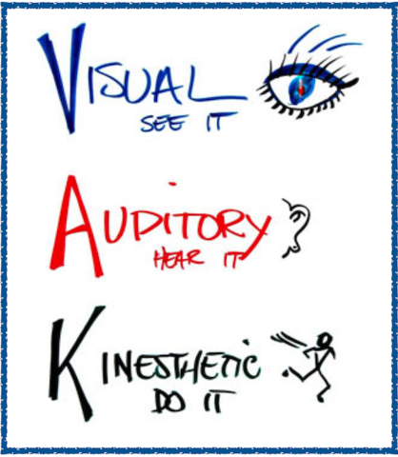
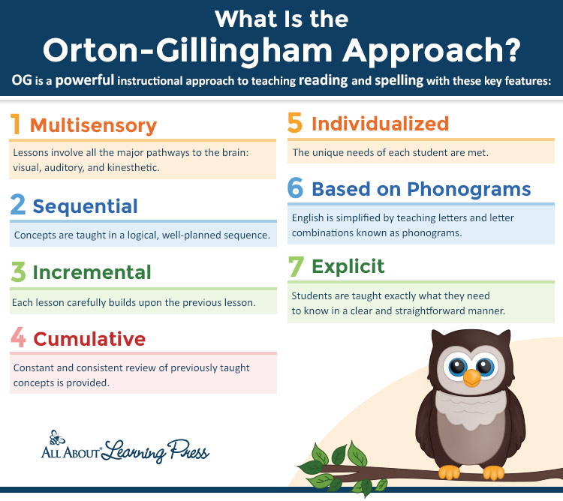
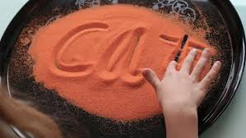
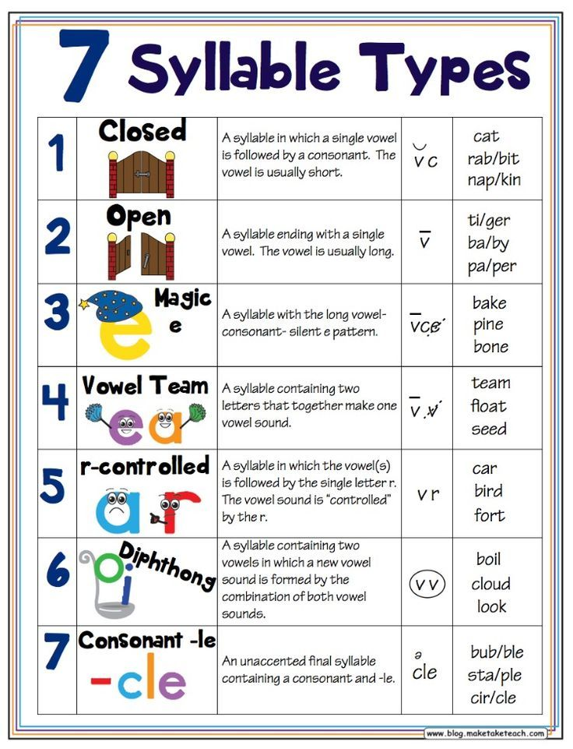
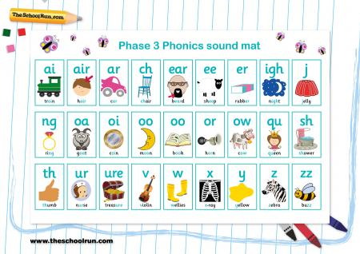
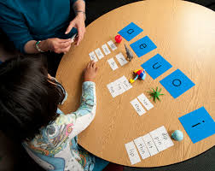
THANKS!
Please keep this slide for attribution.

